Slide 1



Master Device for TAVI Teleoperation Robot Master Thesis
Sensory-Motor systems Lab
Presenter: Armando Amorós
Supervisor: Dr. Robert Riener

Slide 2
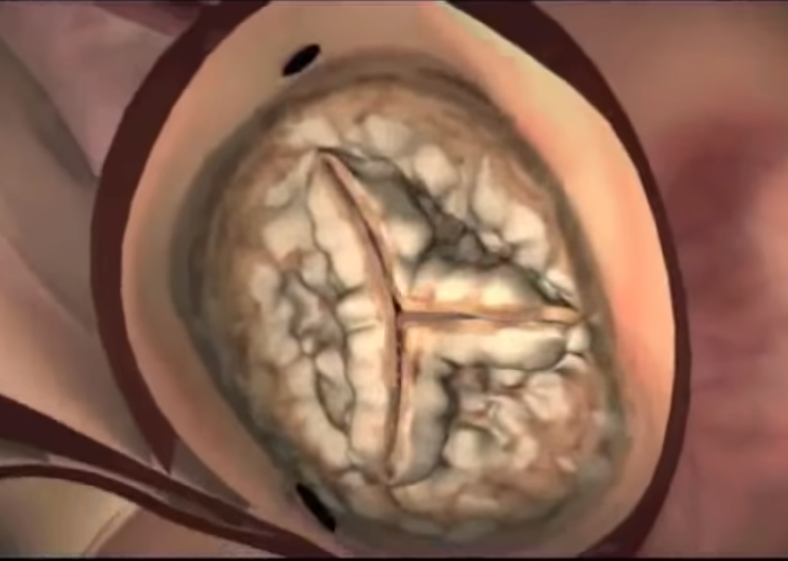
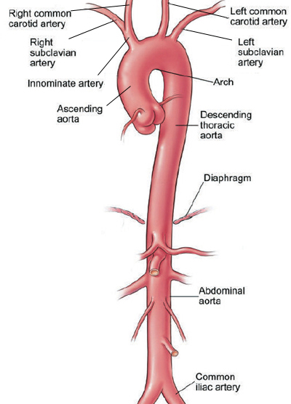
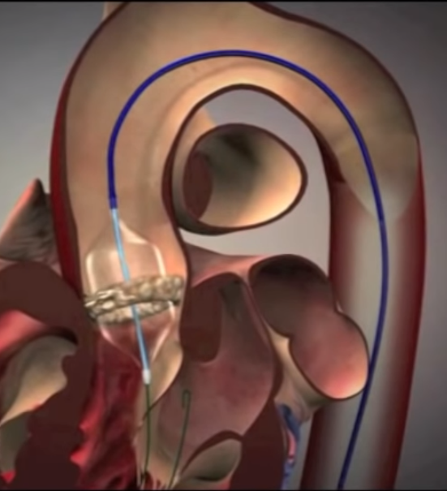
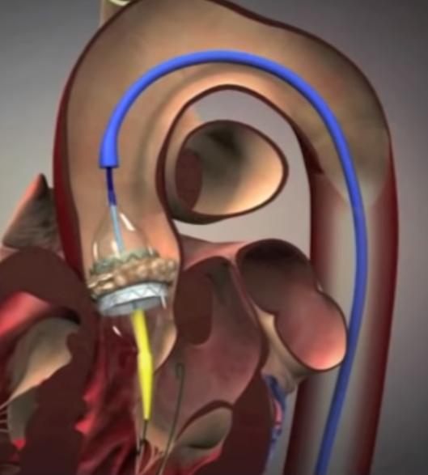
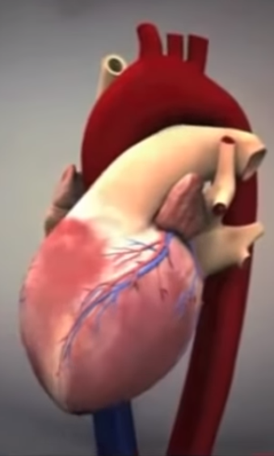
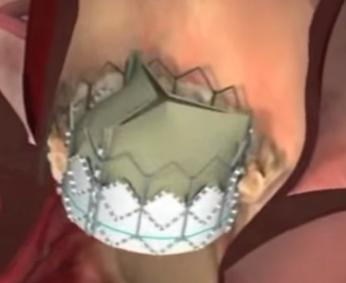
Transcatheter Aortic Valve Implantation/Replacement (TAVI)
Aortic artery
Calcified valve
Old valve displacement
New valve deployment
New valve
Images taken from https://www.maimonidesmed.org/heart-vascular-institute/centers/structural-heart-center/tavr
Notes:
Aortic Artery
Left ventricle through the aortic valve
Fluoroscopy used during the whole intervention to track the catheter and wide wires

Slide 3

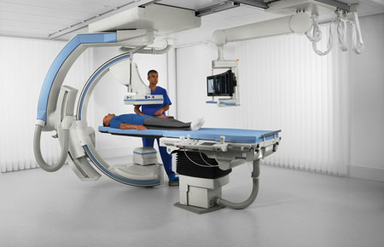
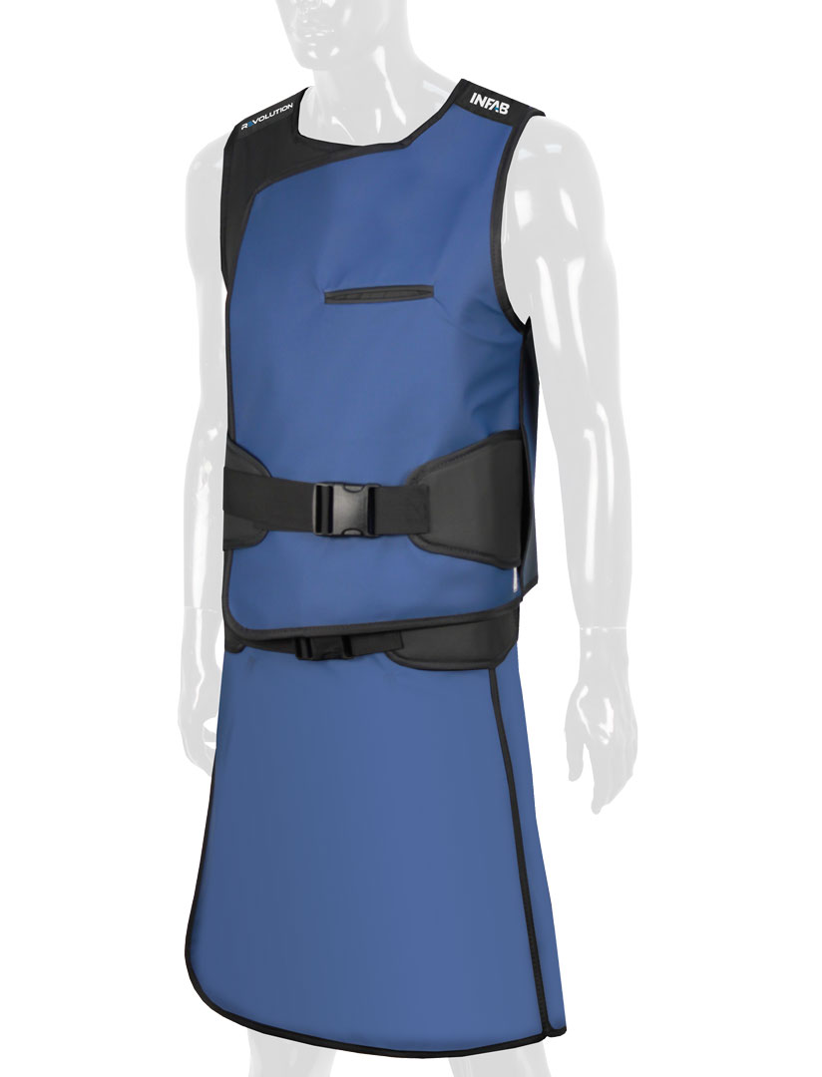

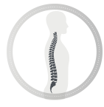
Reduction of radiation illness and orthopedic injuries
Lead vest and skirt around 7 kgs
Most common issues
Fluoroscopy
85% of brain tumors in interventionalists on the left side
50% have significant posterior subcapsular lens changes
https://www.fda.gov/radiation-emitting-products/medical-x-ray-imaging/fluoroscopy
60% have an incidence of spine issues after 21 years in practice
https://www.infabcorp.com/product/revolution-full-overlap-lumbar-vest-skirt-703/
https://www.corindus.com/physician-resources
Notes:
We come into the motivation of this master thesis which is
Subcapsular changes may lead to cataracts
33% miss work due to orthopedic issues
Early atherosclerosis in the carotid artery (Plaque builds inside the arteries)

Slide 4
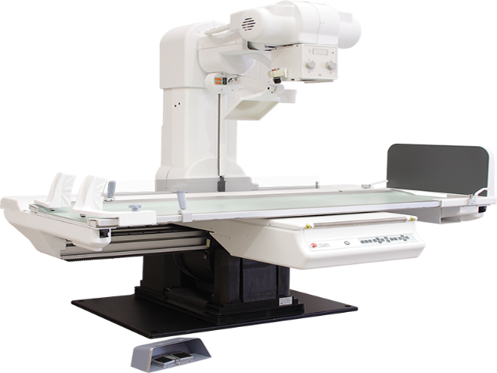
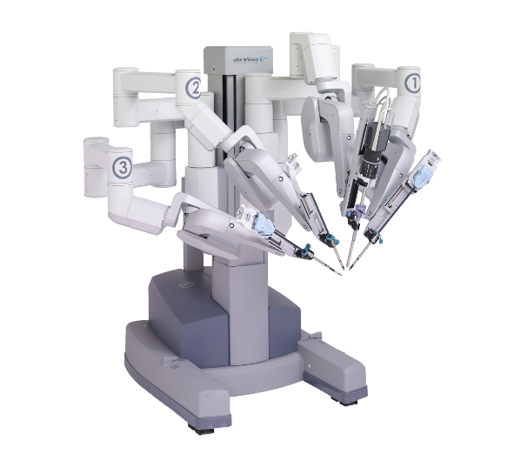

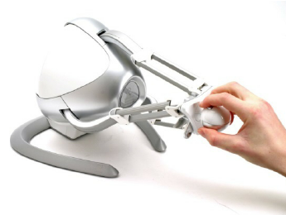

Teleoperation Benefits
Control and sensing
17% Radiation reduction to the patient
95% Radiation reduction to the physicians
Robotic precision
Procedural Control
Fluoroscopy Image
Control feedback
https://www.corindus.com/physician-resources
Visual guidance
Haptic feedback
Input commands
Control and sensing
Input commands

Slide 5
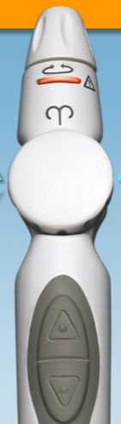
Catheter Robotics Inc. – The Amigo remote control system
3 DOF
Endoscopy

Slide 6
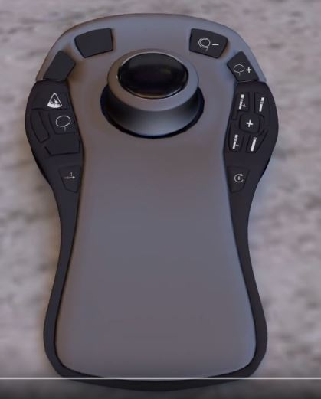
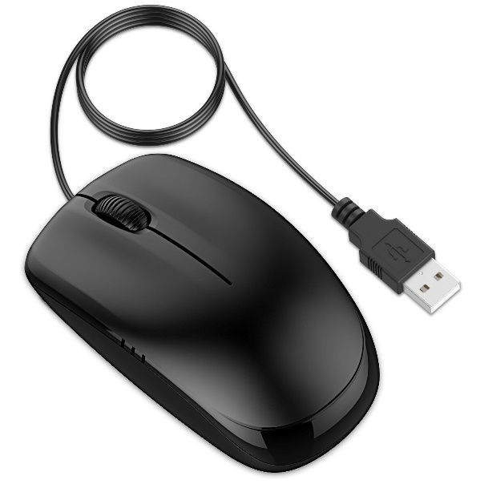
Stereoaxis - Niobe
Magnetic drive
Endoscopy
3D or 2D mouse

Slide 7
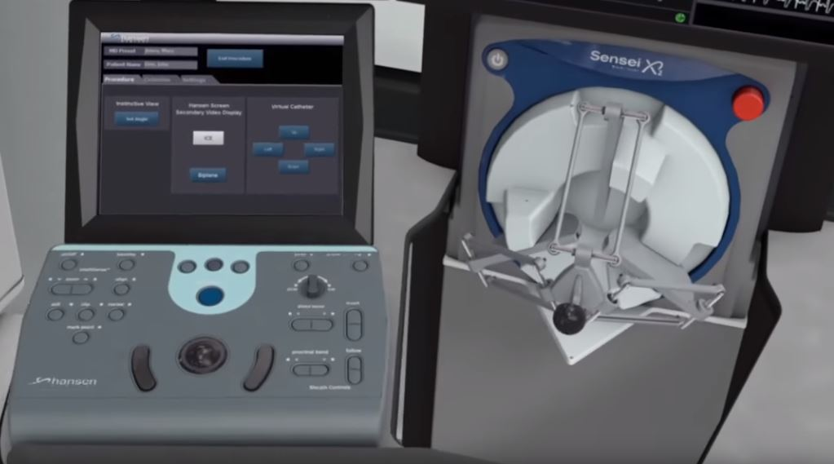
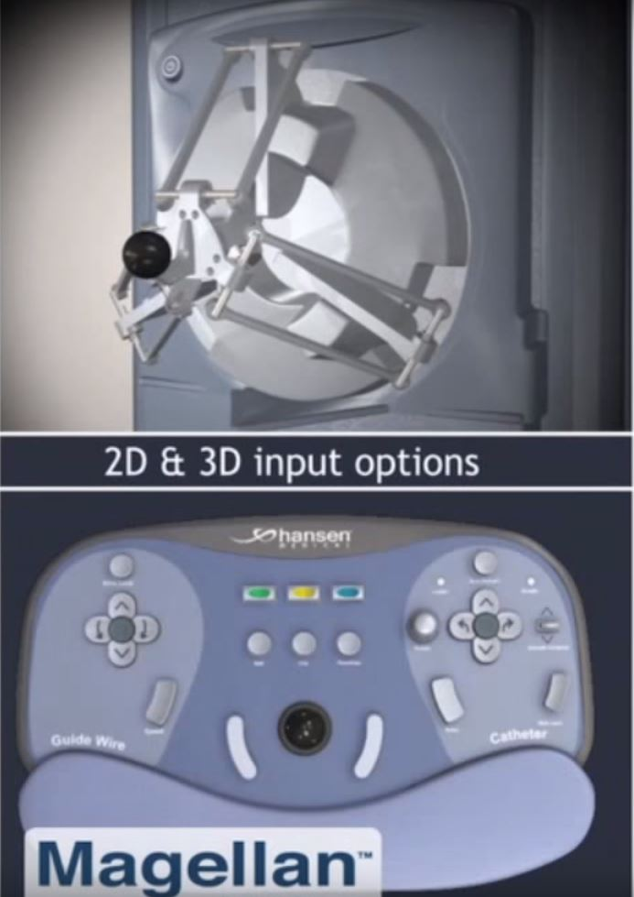
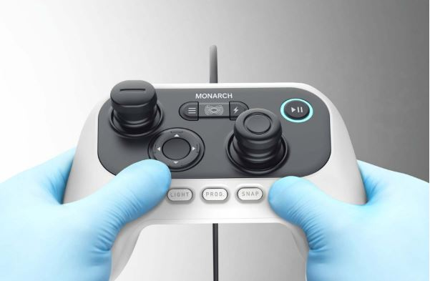
Auris – Hansen Medical
3 DOF
Endoscopy
Magellan
Sensei
Monarch

Slide 8
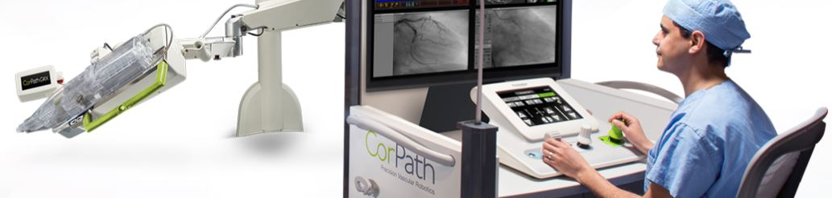
Commercial Robots – CorPath GRX
2 DOF
Guide wire, catheter and stent balloon
One joystick per line
Made for PCI (Percutaneous coronary intervention)

Slide 9
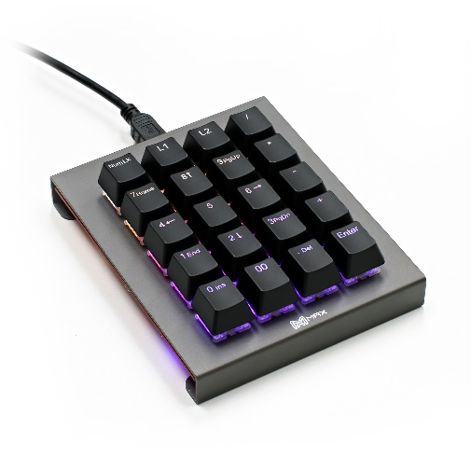
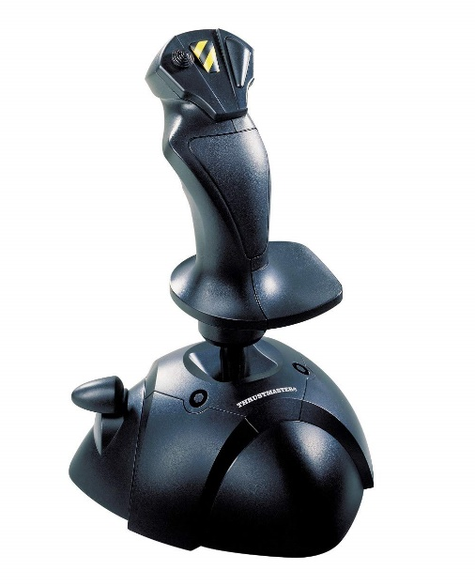

Thesis objective
Find the most suitable master device for TAVI teleoperation
Notes:
So, the objective of this thesis is to test between a variety of input devices and select the one that results more suitable for TAVI teleoperation

Slide 10
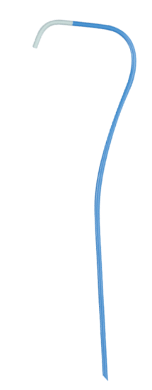
Common Characteristics of all Devices
Manage 2 DOF (Degrees of freedom)
1st DOF Axial movement
2nd DOF Rotation movement
No tip control
1st DOF
2nd DOF
Notes:
Each one of the devices has to be able to control the catheter in the following way

Slide 11
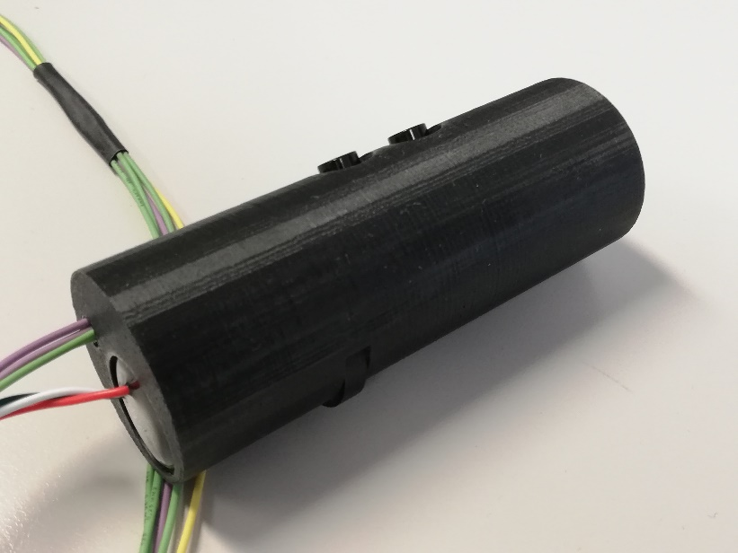
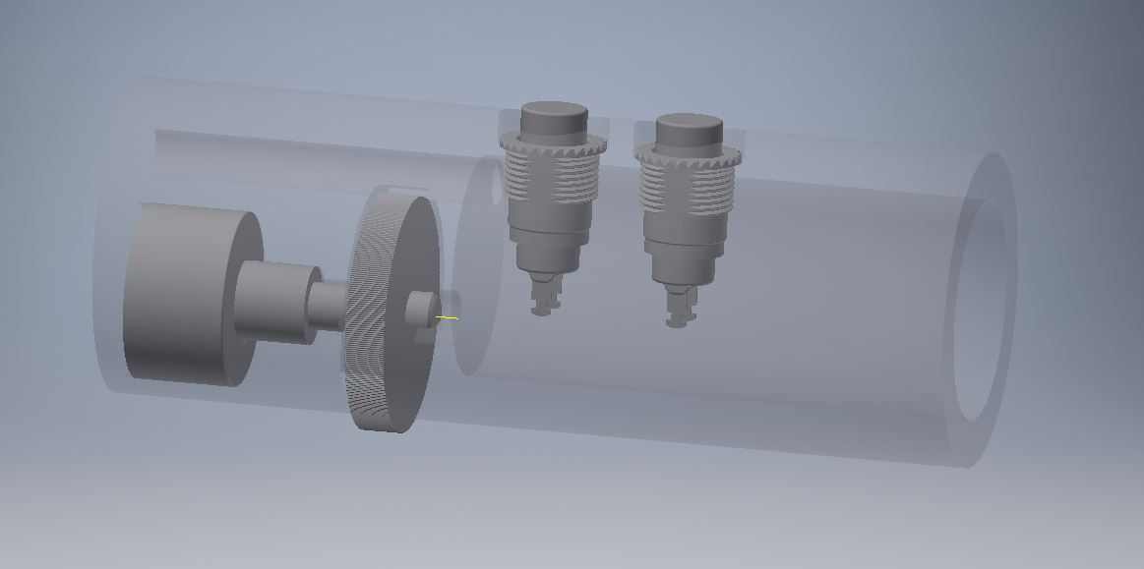
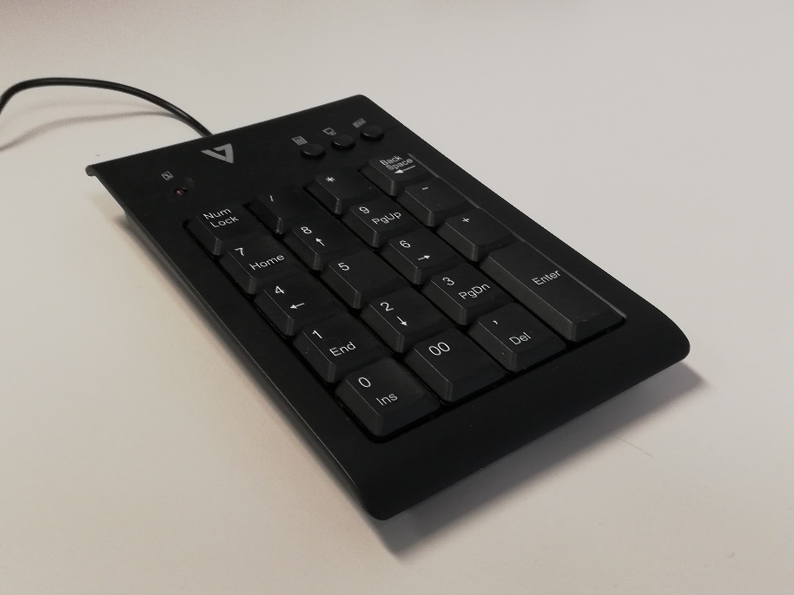
Keyboard Remote
1st DOF – Up and Down keys, Pressed Time* - Velocity
2nd DOF – Left and Right keys, Pressed Time* - Velocity
1st DOF – Up and Down buttons, Pressed Time* - Velocity (Push Buttons)
2nd DOF – Rotation disk, velocity to velocity mapping (Rotatory non contact sensor)
Notes:
So know we are heading into th devices I chose to test, and how each one of them individually manage the 2 DOF
- Make remarks about analogic and digital

Slide 12
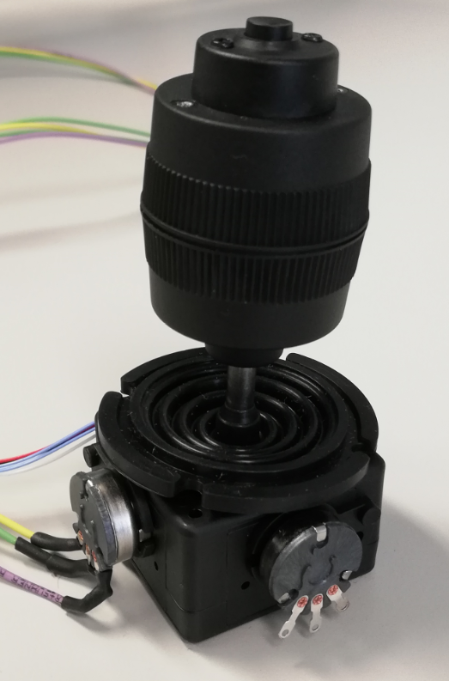
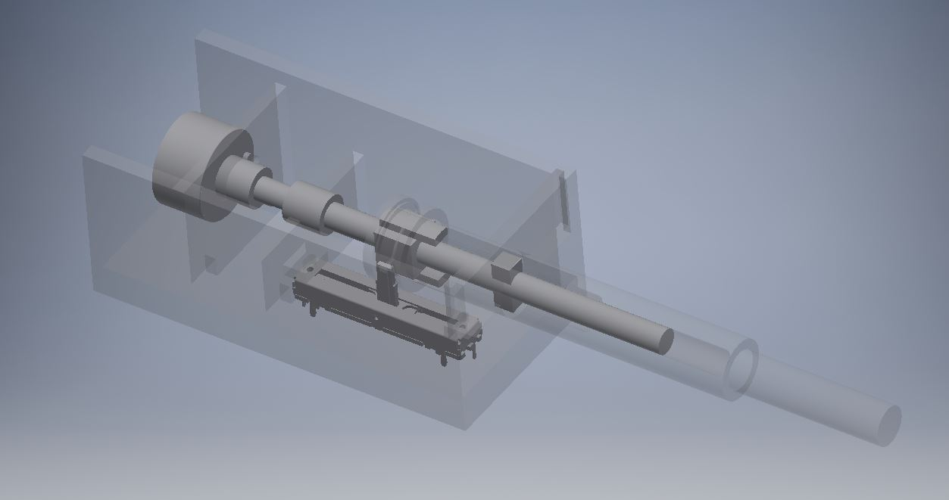
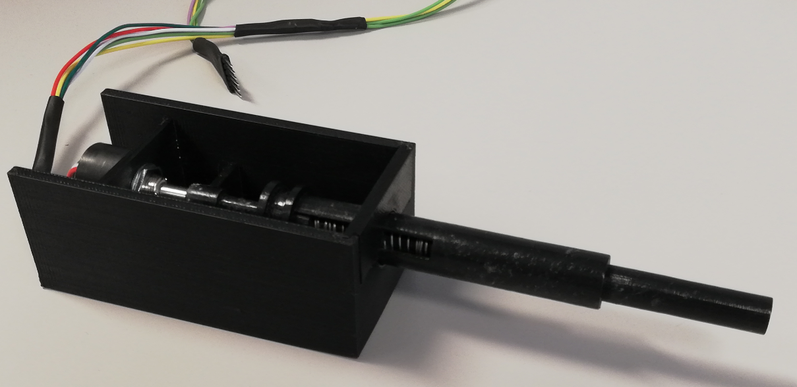
Joystick Catheter like
1st DOF – Push and pull motion , distance to velocity (with potentiometer)
2nd DOF – Rotation over axis , velocity to velocity (Rotatory non contact sensor)
1st DOF – Front and back rotation, distance to velocity (with potentiometer)
2nd DOF – Rotation over axis , distance to velocity (with potentiometer)

Slide 13
Advantages and Disadvantages
Type | Mapping | Device | Advantages | Disadvantages
Analogic | Position - Velocity | Joystick (Axial & Rotation) Catheter (Axial) | High Resolution with high control | No instant stop, prone to overshot Additional mechanics
 | Velocity - Velocity | Remote (Rotation) Catheter (Rotation) | Simplified mechanics Instant stop | Resolution highly dependent on sampling rate in combination with communication rate
Digital | Pressed Time* - Velocity | Keyboard (Axial & Rotation) Remote (Axial) | Simpler for first time users Instant stop when releasing the | Once released, it is necessary to build up velocity again No control in velocity
* Velocity of digital devices increases linearly over time with an initial offset
Notes:
* Talk about the dead zone

Slide 14


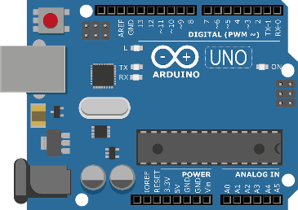
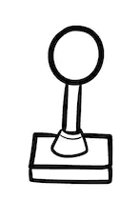
Experiments setup
Send velocities
Matlab sampling rate 30ms
Arduino process the velocities internally
Arduino sampling rate matched with Matlab for velocity – velocity devices
Serial communication
Graphics process
Velocity request interruption
Velocity processing
Analogic / Digital Signals

Slide 15
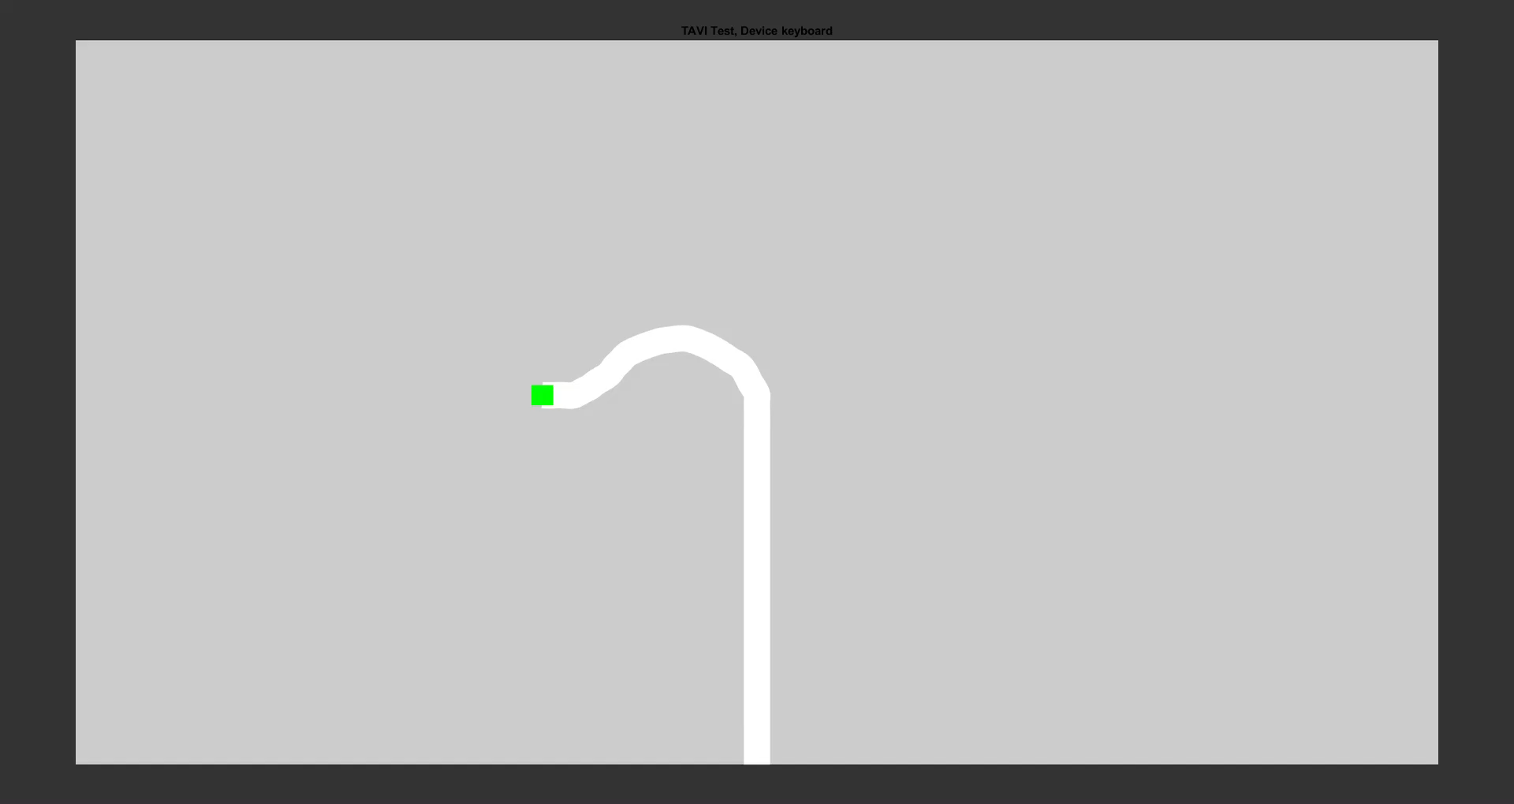
Graphic Environment
2D representation of a catheter (simulation fluoroscopy image)
1st DOF (Axial movement) Up and Down
2nd DOF (Rotation movement) Left and Right
Green dot is the tip of the catheter
Catheter sinusoidal movement in rotation

Slide 16
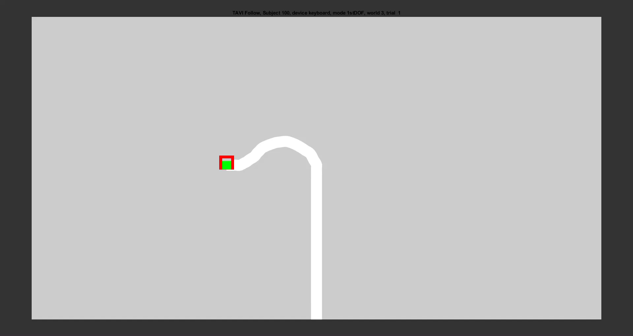
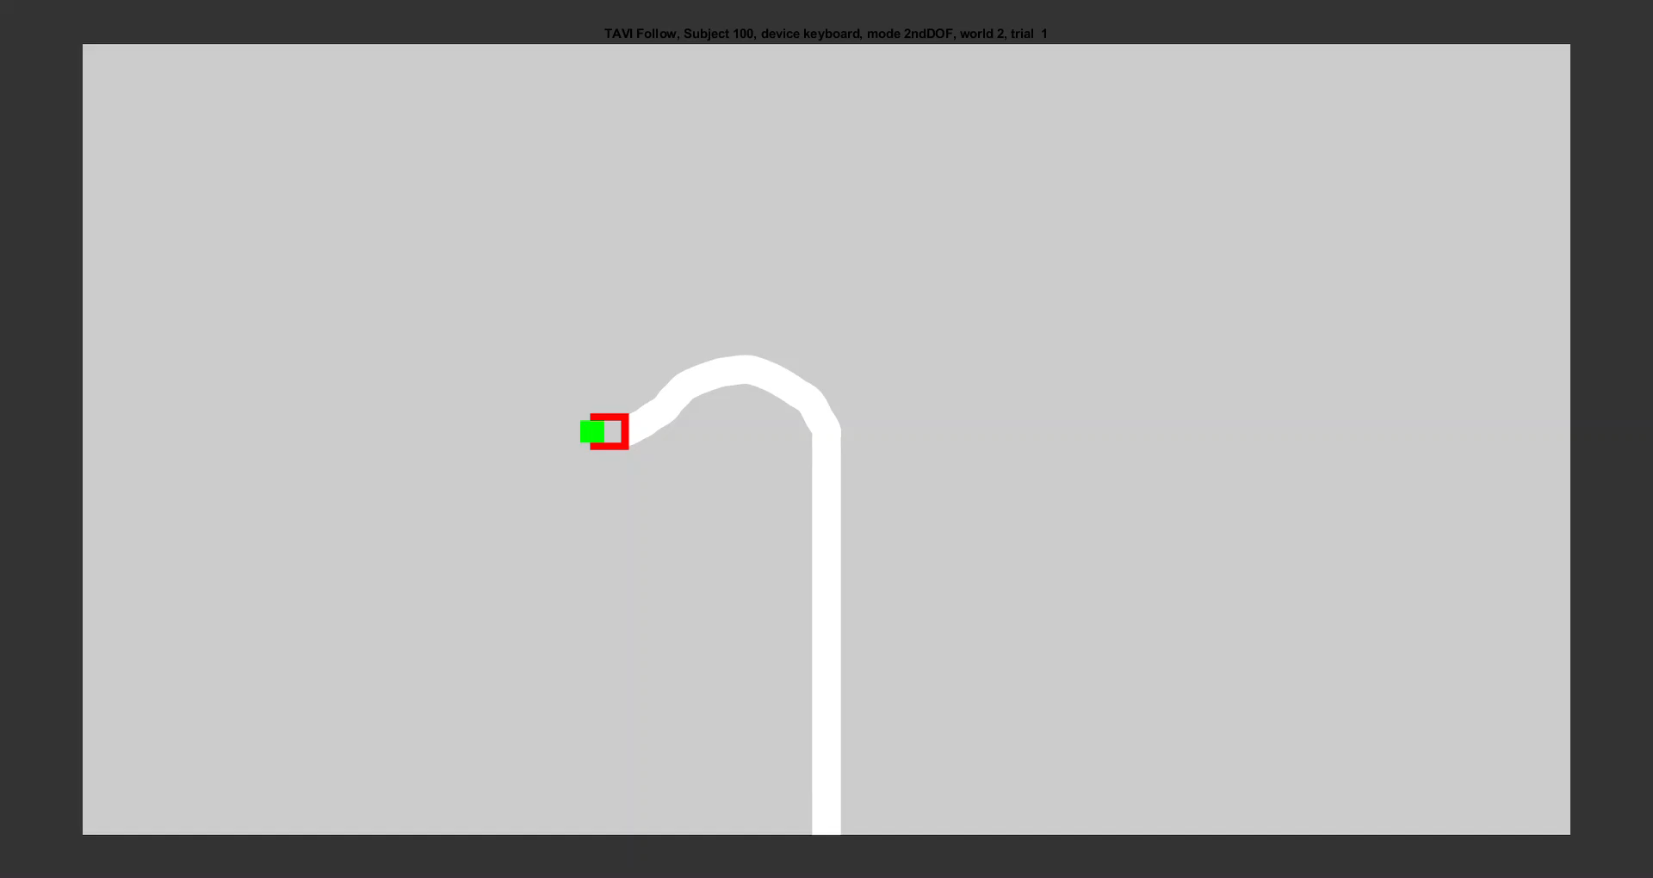
Experiment 1st DOF and 2nd DOF
Objective:
Try to collocate the tip of the catheter (green square) inside the target (red square)
Metrics:
RMSE in X and Y
Worlds (scenarios):
3 different target trajectories per experiment
Repetitions:
5 Times per world
5 * 3Worlds *4Devices = 60Repetitions per experiment
10 seconds each

Slide 17
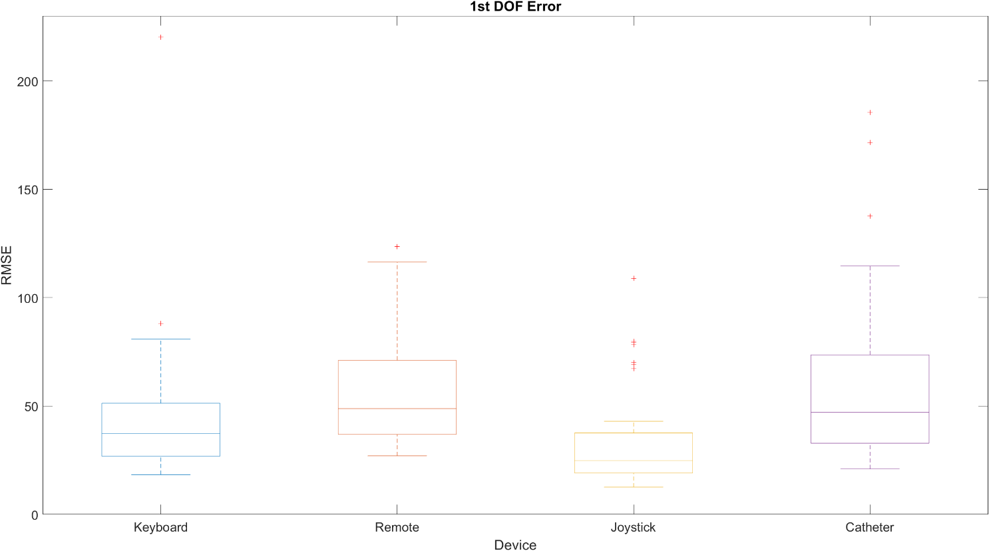
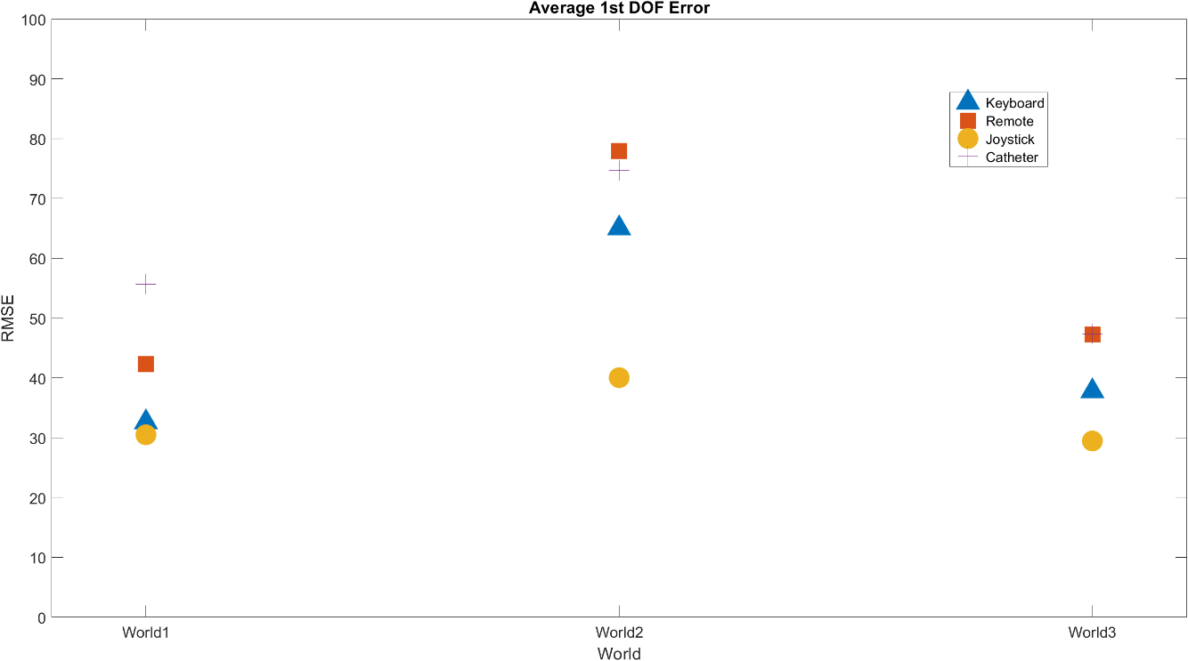
1stDOF Experiment
Joystick is not significantly better than keyboard due to interaction P-Value = 0.006

Slide 18
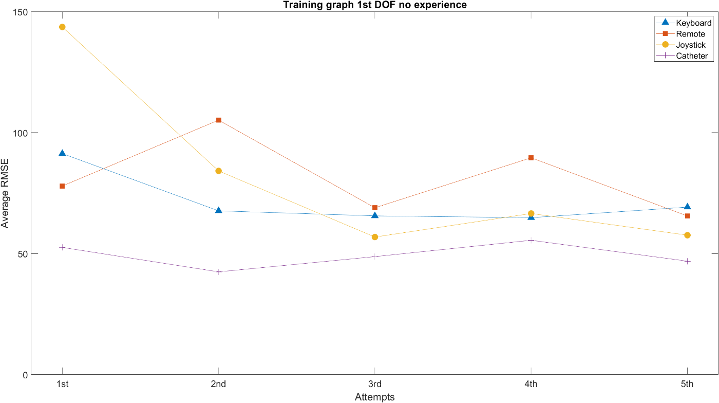
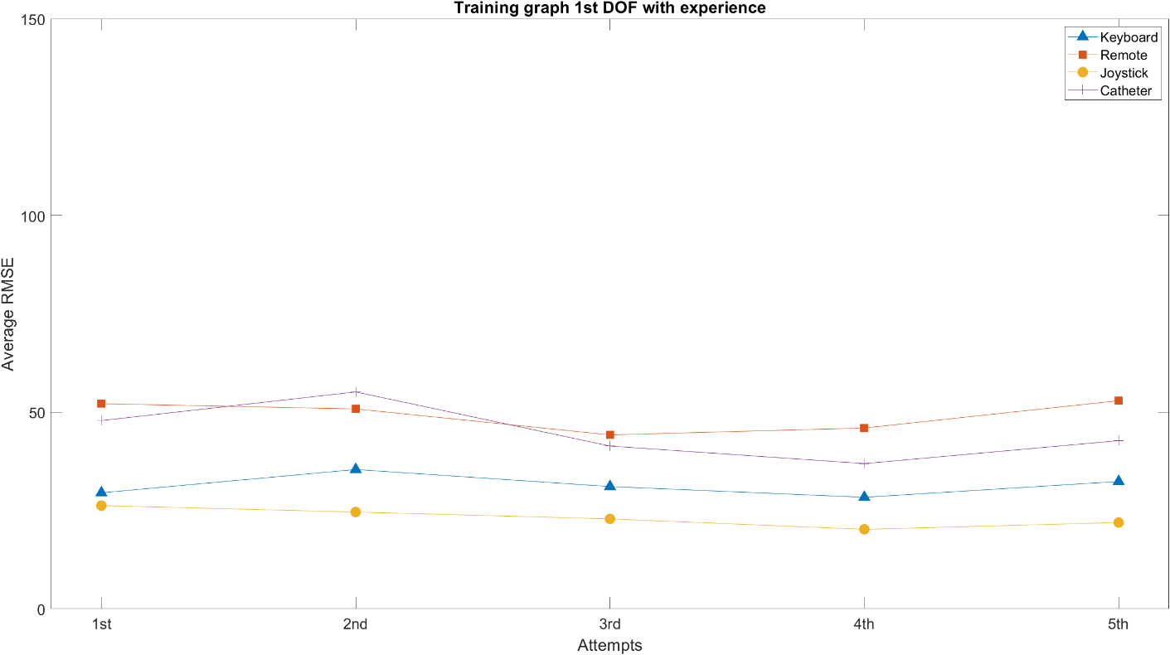
1stDOF Learning/Training Curve

Slide 19
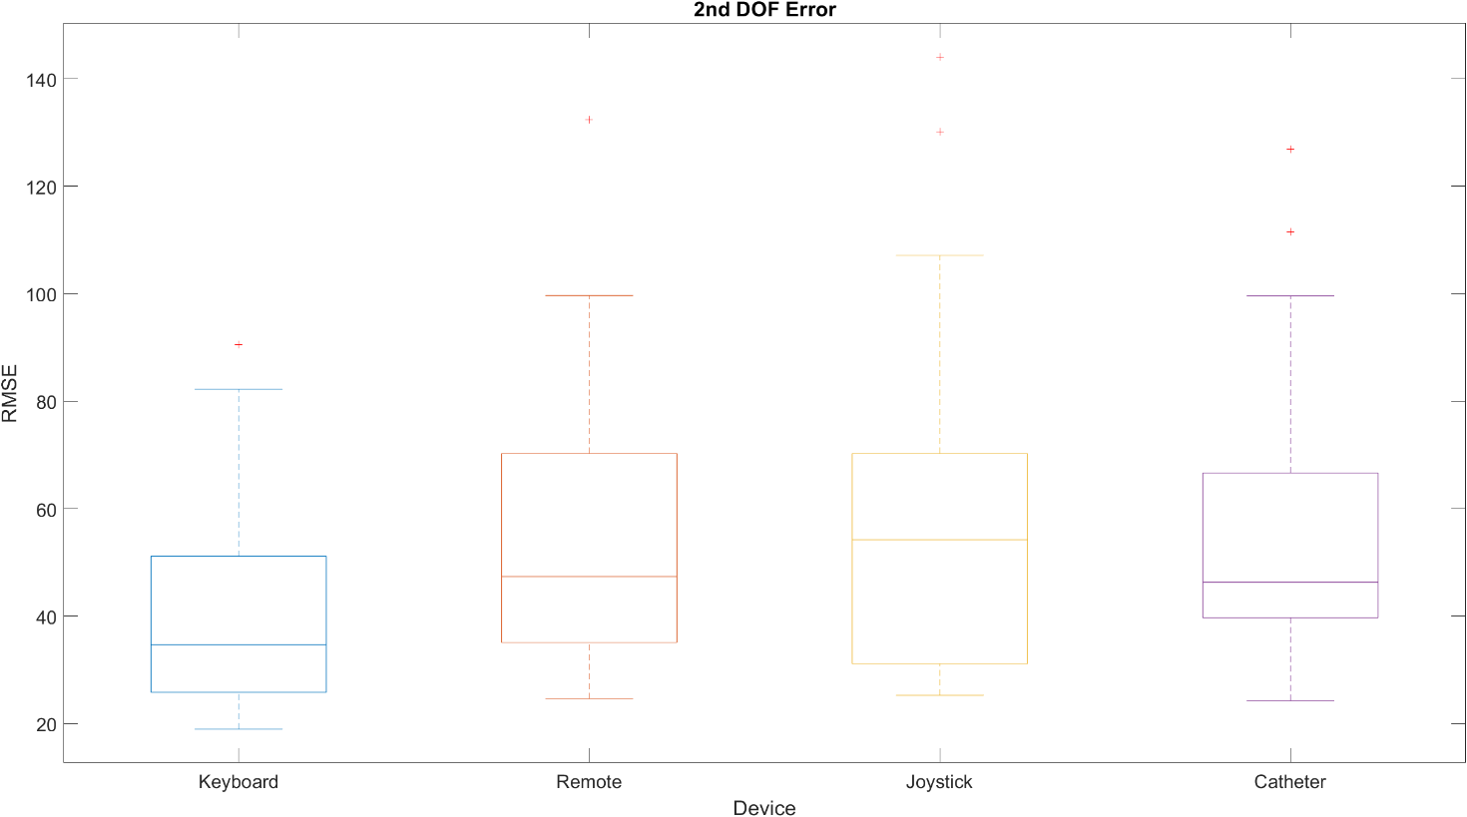
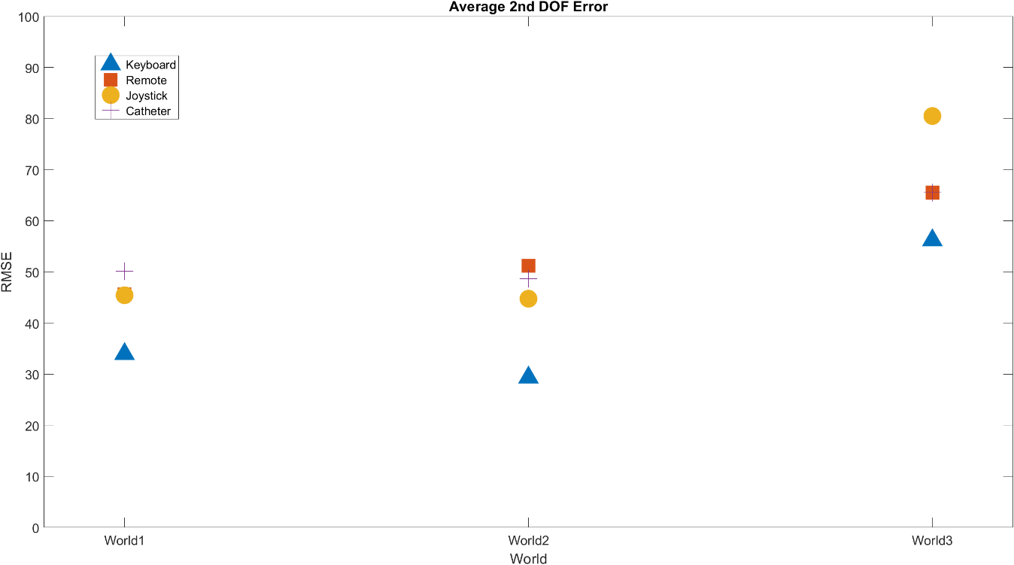
2ndDOF Experiment
Keyboard is significantly better than all other devices with P-Values < 4.50E-10

Slide 20
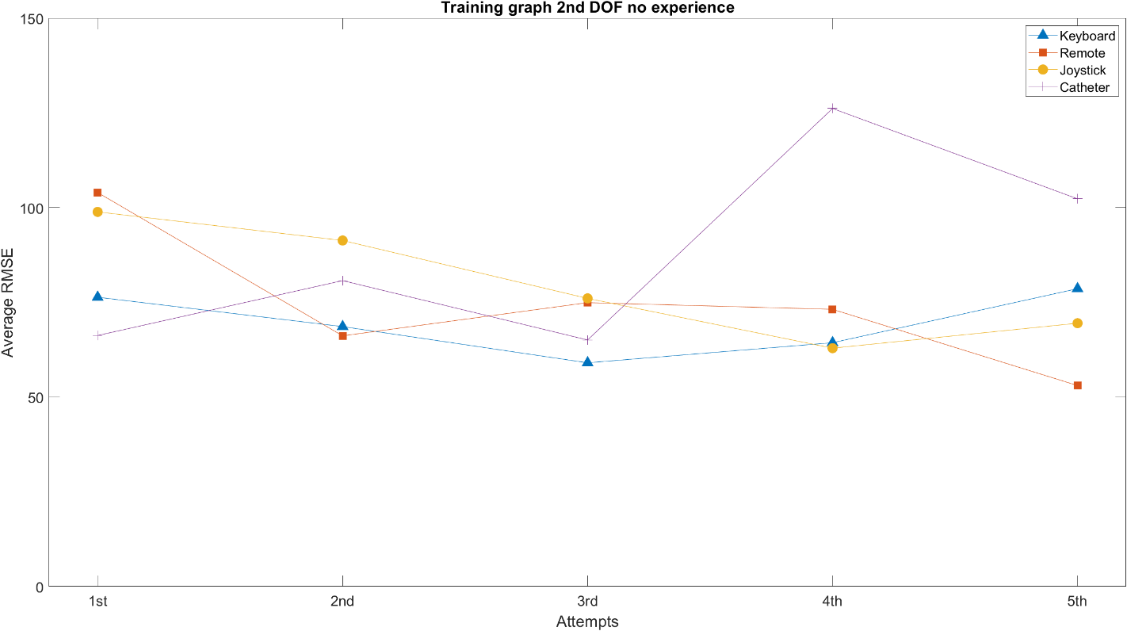
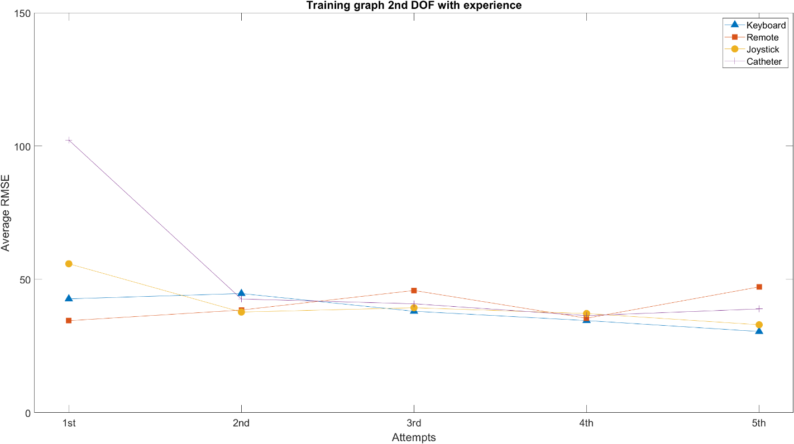
2ndDOF Learning/Training Curve

Slide 21
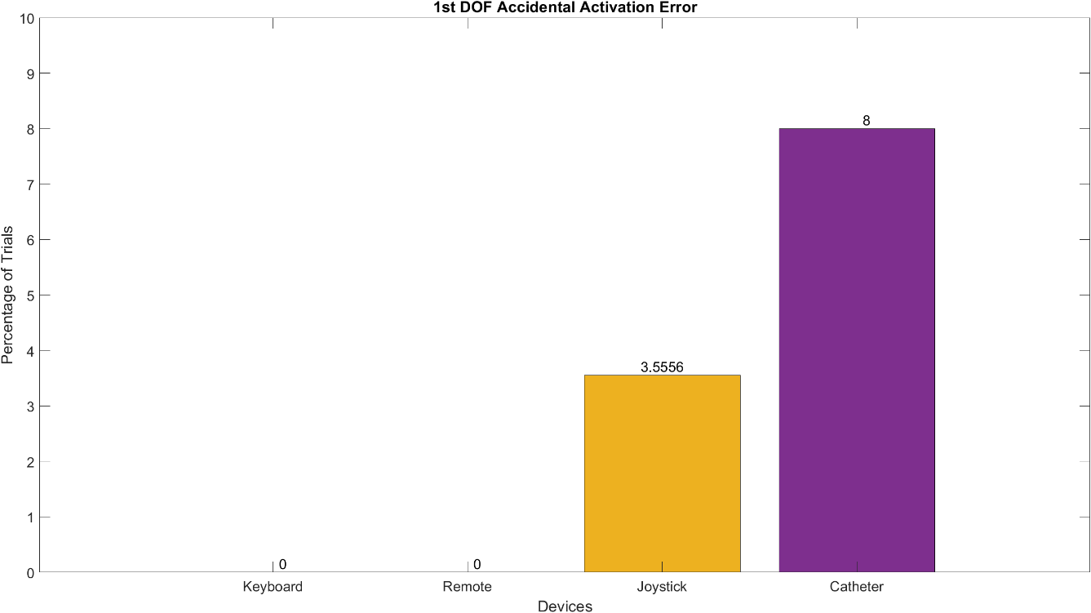
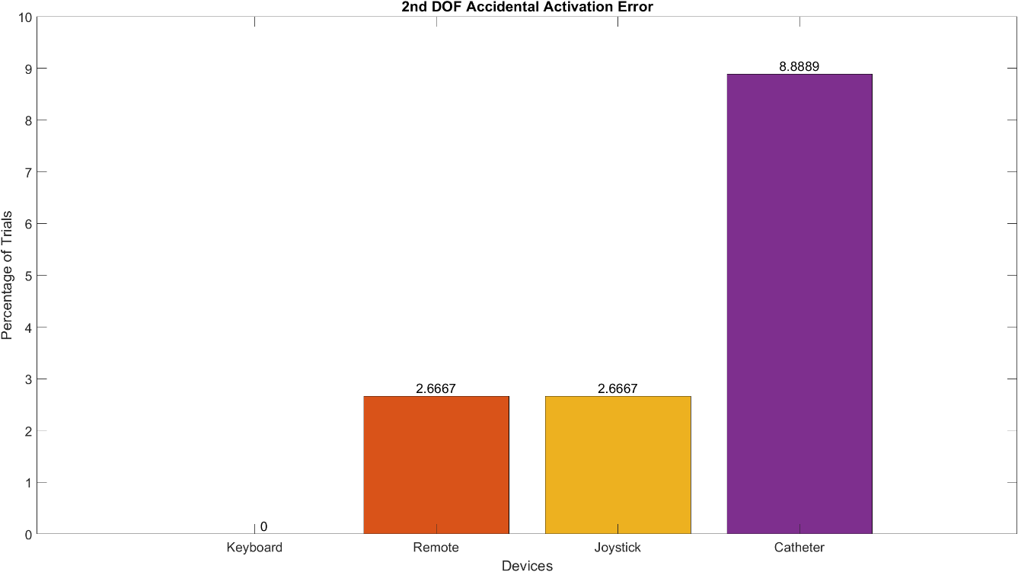
Activation Error
Digital devices are significantly better than Joystick with P-Value around 0.01
Digital devices are significantly better than Catheter with P-Value around 0.001

Slide 22
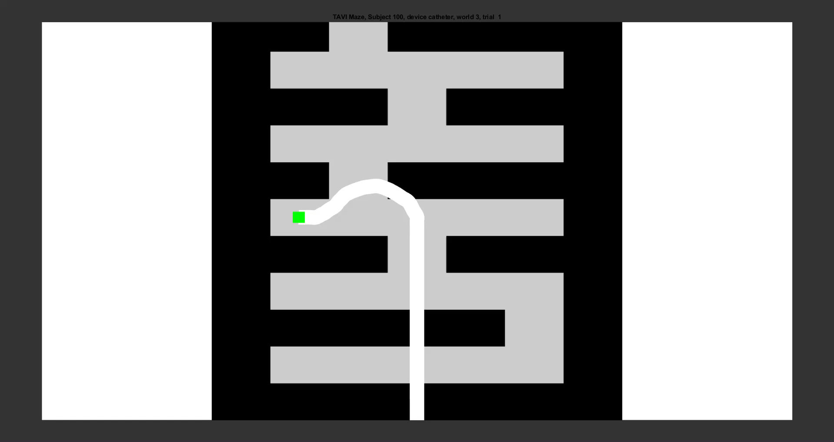

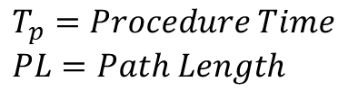

Experiment Maze
Objective:
Navigate trough the maze until reaching the upper wall
Reach the upper wall as fast as possible
Avoid collisions with the walls and keep as much distance as possible
Metrics:
Time
Number of Collisions
Dimensionless Squared Jerk
Worlds (scenarios):
2 different mazes
Repetitions:
5 Times per world
5 * 2Worlds *4Devices = 40Repetitions per experiment
No time limited
$$J_{d}=\left(\int_{t_{i}}^{t_{e}}{{\left(\overset{⃛}{x}\left(t\right)\right)}^{2}+{\left(\overset{⃛}{y}\left(t\right)\right)}^{2} dt}\right)∗\frac{T_{p}^{5}}{PL^{2}}$$
$$T_{p}=Procedure Time \\ PL=Path Length$$
Notes:
How important is DSJ

Slide 23
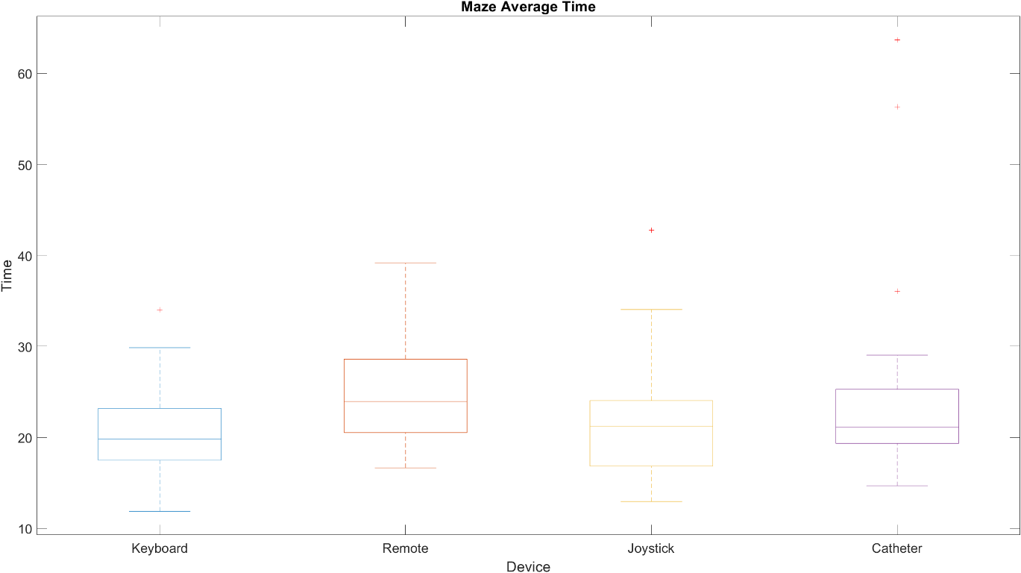
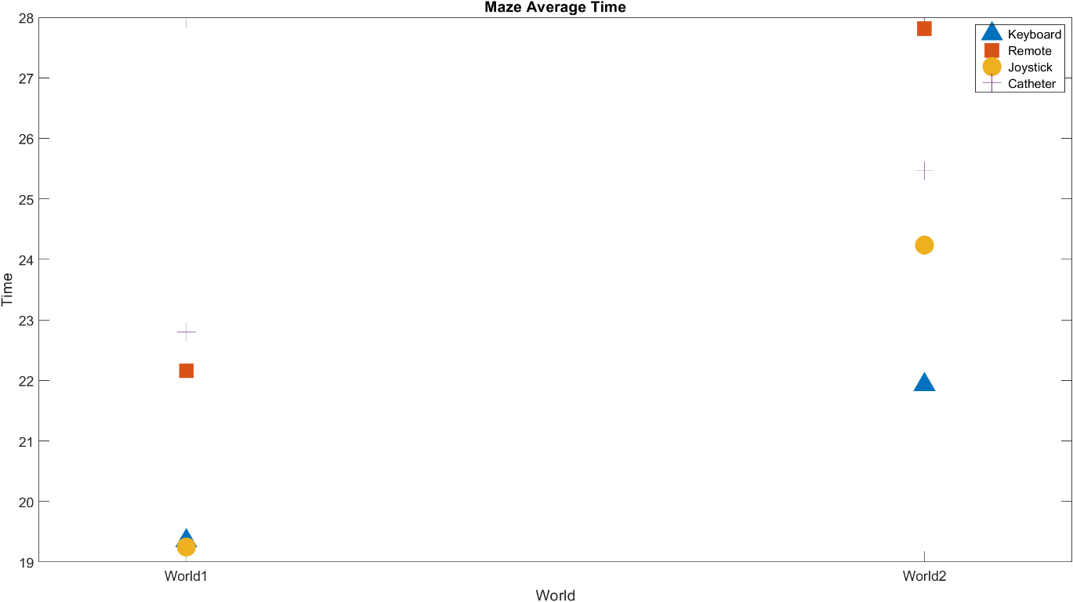
Maze Experiment Time
There were no consistent significative differences between the devices due to interactions P-values < 0.05

Slide 24
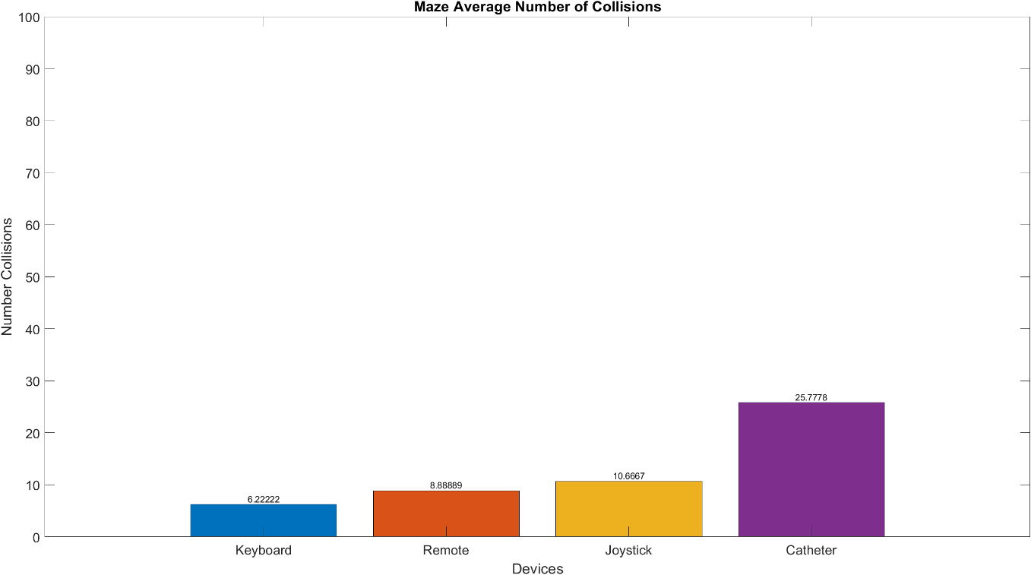
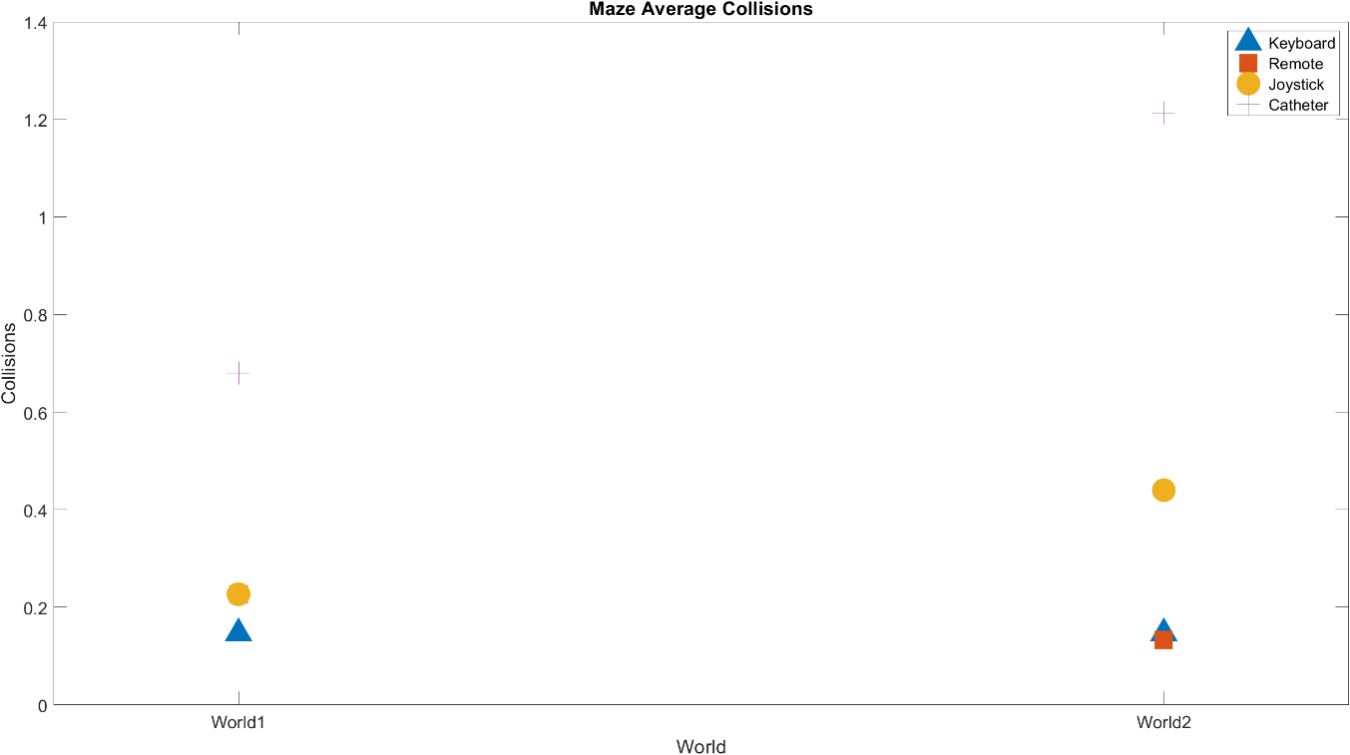
Maze Experiment Number of Collisions
Keyboard and Remote were significantly better than Joystick and Catheter with P-Values around 0.01
This results may be due overshoots in analogical devices

Slide 25


Maze Experiment DSJ (Dimensionless Squared Jerk)
There were no consistent significative differences between the devices due to interactions P-values < 0.05

Slide 26




Poll results

Slide 27
Participants statistics and comments
Number of participants: 15
Average age: 30.23
% M: 46.15
% F: 53.85
Most relevant comments
Remote appears to be significantly slower than keyboard
Takes some time to operate the joystick, but with time it feels the easiest to use
Rotation in Joystick has too much dead zone and no low velocity
(From Surgeon) Joystick as main device and Remote as detachable device

Slide 28
Conclusions
After the experiments and given the results in the:
1st DOF Experiment
Dimensionless squared jerk
Training curves
Poll results and comments
I consider the Joystick to be the most suitable option as a master device for the TAVI teleoperation robot

Slide 29
Possible Following Steps
Explore mapping functions for analogic devices (other than linear)
Explore feedback strategies for a haptic device
Explore the possibility to have two master devices, adding a detachable secondary master device

